Slide 1

SQL Server

Slide 2
Introduction to Database

Slide 3

Outline
What is Database and use of DB?
Different Types of Databases
How Are Databases Used in the Real World?
What is DBMS and RDBMS
Data models in DBMS

Slide 4
What is Data ?
Data is a collection of a distinct small unit of information. It can be used in a variety of forms like text, numbers, media, bytes, etc. it can be stored in pieces of paper or electronic memory, etc.
What is Database ?
A database is an organized collection of data, so that it can be easily accessed and managed.
A database is usually controlled by a database management system (DBMS)
The main purpose of the database is to operate a large amount of information by storing, retrieving, and managing data.
Types of Databases:
Relational DB : Data is represented in terms of tuples (rows) in RDBMS.
Non-Relational DB (NoSQL) : NoSQL databases are useful for a large set of distributed data.
Cloud DB : Cloud database facilitates you to store, manage, and retrieve their structured, unstructured data
via a cloud platform. This data is accessible over the Internet.

Slide 5
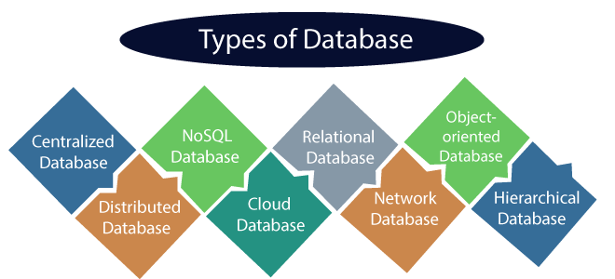
RDBMS
Oracle
MySQL
Microsoft SQL Server
Postgre SQL
IBM DB2
Informix
Sybase
No SQL DB
MongoDB
Hbase
Couch DB
Cassandra
Cloud DB
Microsoft Azure
AWS
IBM
Google Cloud Platform

Slide 6
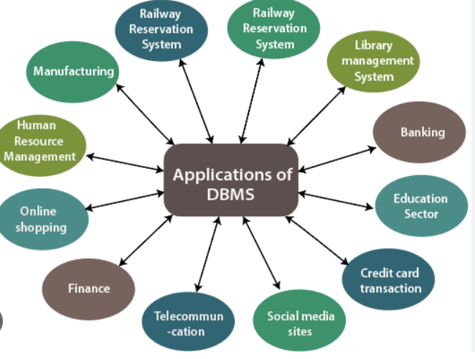
How Are Databases Used in the Real World?
Databases are used in real world the below business sectors
Telecom
Healthcare
Retail
Banking / Credit Union
Finance and Insurance
Education
Tours and Travels
Import and Export (Logistics)
Ecommerce

Slide 7
DBMS vs RDBMS
DBMS | RDBMS
DBMS applications store data as file. | RDBMS applications store data in a tabular form.
Normalization is not present in DBMS. | Normalization is present in RDBMS.
DBMS does not apply any security with regards to data manipulation. | RDBMS defines the integrity constraint for the purpose of ACID Property
DBMS is meant to be for small organization and deal with small data. it supports single user. | RDBMS is designed to handle large amount of data. it supports multiple users.
Data redundancy is common in DBMS | Keys and Indexes do not allow Data
DBMS not support for Client-Server Technology | RDBMS support for Client – Server Technology
Examples: XML/JSON and FoxPro | Examples: SQL Server, Oracle and MySQL…etc.

Slide 8
Data Models in DBMS
Data models in DBMS help to understand the design at the conceptual, physical, and logical levels as it provides a clear picture of the data making it easier for developers to create a physical database.
Data models are used to describe how the data is stored, accessed, and updated in a DBMS.
Types of Data Model
Hierarchical Model
Network Model
Entity-Relationship model (ER Model)
Relational Model
Object-Oriented Data model

Slide 9
E-R Modeling and Diagrams

Slide 10
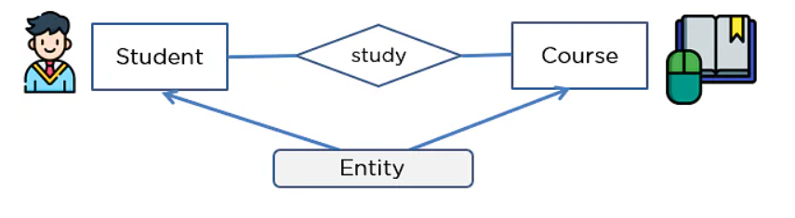
What is an ER Model?
An Entity-Relationship Model represents the structure of the database with the help of a diagram
ER Diagram gives a better understanding of the information to be stored in a database
It reduces complexity and allows database designers to build databases quickly
It allows users to get a preview of the logical structure of the database
Components of ER Diagram
1. Entities
2. Attributes
3. Relationships
Entities :
Entities are nothing but Heading of the Table Or View

Slide 11
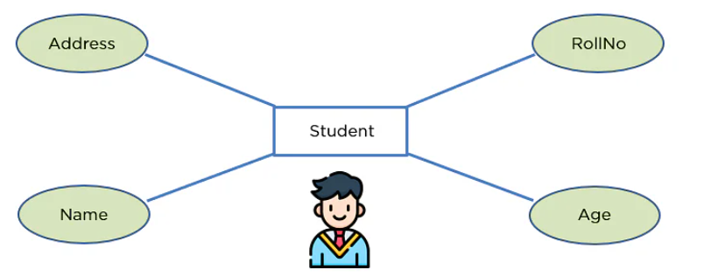
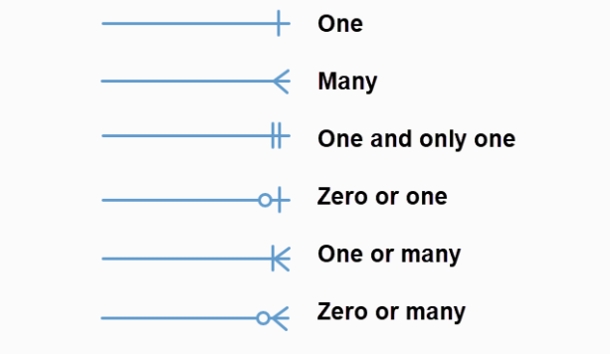
Attributes
An attribute exhibits the properties of an entity.
Relationship
Relationship is nothing but an association among two or more entities.
Types:
One-to-One Relationships
One-to-Many Relationships
May to One Relationships
Many-to-Many Relationships

Slide 12
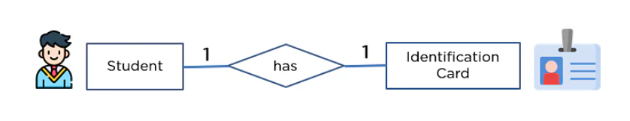



One-to-One Relationship
One-to-Many Relationship
Many-to-One Relationship
Many-to-Many Relationship

Slide 13
Normalization and Denormalization

Slide 14
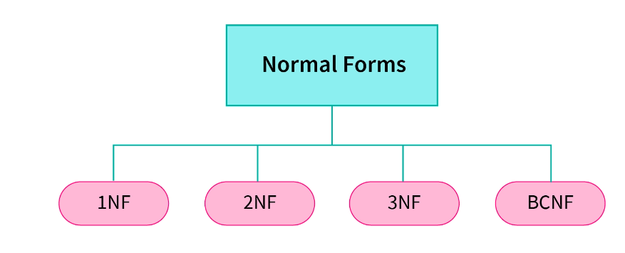
Normalization
Normalization is the process of organizing the data in the database.
Normalization is used to minimize the redundancy from a relation or set of relations.
It is also used to eliminate undesirable characteristics like Insertion, Update, and Deletion Anomalies.
Normalization divides the larger table into smaller and links them using relationships.
The normal form is used to reduce redundancy from the database table.
Types of Normalization
Notes:
https://www.scaler.com/topics/denormalization-in-dbms/

Slide 15
De Normalization
Traditionally data is stored in normalized databases, in which multiple separate tables are maintained in a relational database to minimize the redundant data. Therefore, whenever we have to access data from multiple tables, we need to perform complex and costly join operations on the required tables.
Denormalization does not mean that the database is never normalized. It is just a method of optimizing databases that is implemented after normalization has been achieved.
Pros of Denormalization
Enhanced Query Performance
More convenient to manage databases
Facilitate and accelerate reporting

Slide 16
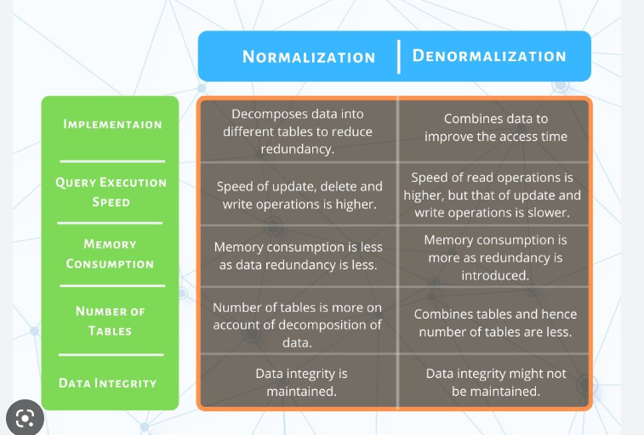
Normalization vs Denormalization

Slide 17
Data Types

Slide 18
Data Types
SQL Server provides built-in data types for all kinds of data that can be used within SQL Server. Additionally, you can also define your own data type in T-SQL.
Category | Data Types
Exact numerics | bit, tinyint, smallint, int, bigint, decimal, numeric, money, smallmoney
Approximate numerics | Real, Float
Date & Time | date, smalldatetime, datetime, datetime2, datetimeoffset, time
Character strings | char, varchar, text
Unicode Character strings | nchar, nvarchar, ntext
Other data types | cursor, hierarchyid, sql_variant, spatial Geometry types, spatial Geography types, rowversion, uniqueidentifier, xml, table

Slide 19
SQL Server Languages

Slide 20
SQL Server Languages (DML, DDL, TCL, DCL)
SQL Basic Commands
SQL Server Languages
DML
DDL
TCL
DCL
Insert
Update
Delete
Select
Create
Alter
Drop
Truncate
Commit
Rollback
Save Transaction
Grant
Revoke

Slide 21
Operators and Aliases

Slide 22
Operators in SQL
An operator is a symbol which is used to perform some action on given expressions.
There are six types of SQL operators
Operator name | Description / Examples
Arithmetic operators | Arithmetic operators are used for mathematical operations on numerical data. Examples : + , - , *, / , %
Bitwise operators | Bitwise operators convert the integers into binary bits and then perform the operation. Examples: &, &=, I ,I=, ^, ^=
Comparison operators | A comparison operator is used to compare two values and test whether they are the same. Examples: = ,> ,< ,>=,<= ,<>
Compound operators | Compound operators perform an operation on a variable and then set the result of the variable to the result of the operation. Examples: +=,-=,*=,/=
Logical operators | Logical operators are those that return true or false. Examples: All, Any/some ,In, All, And, OR, Not, Like ,IS null, Between, Exists
String operators | String operators are primarily used for string concatenation (combining two or more strings together) and string pattern matching. Examples: + , += , [] , %, [^], _
Notes:
Reference : https://www.dataquest.io/blog/sql-operators/

Slide 23
Aliases
Aliases can be used to create a temporary name for columns or tables.
Two types of Aliases
1. Column Aliase 2. Table Aliase
The syntax to alias a column in SQL Server:
The syntax to alias a table in SQL Server
Note: If the alias_name contains spaces, you must enclose the alias_name in quotes.
The alias_name is only valid within the scope of the SQL statement.
column_name [ AS ] alias_name
column_name [ AS ] alias_name

Slide 24
Functions

Slide 25
Functions in SQL
Types of Functions
1. System defined function 2. User defined function
Functions that are defined by the system are known as system functions or built-in functions
Functions that are created by the user in the system database or a user-defined database are known as user-defined functions.
String Functions
Date and Time Functions
Aggregate Functions
Mathematical Functions
Ranking Functions
Null Functions
Scalar Functions
Table-Valued Functions

Slide 26
String Functions
Function | Description
CONCAT | Join two or more strings into one string
LEN | Join two or more strings into one string
LOWER | Convert a string to lowercase
UPPER | Convert a string to uppercase
TRIM | Return a new string from a specified string after removing all leading and trailing blanks
REPLACE | Replace all occurrences of a substring, within a string, with another substring
TRANSLATE | Replace several single-characters, one-to-one translation in one operation.
STUFF | Delete a part of a string and then insert another substring into the string starting at a specified position.
SUBSTRING | Extract a substring within a string starting from a specified location with a specified length
LEFT | Extract a given a number of characters from a character string starting from the left
SPACE | Returns a string of repeated spaces.

Slide 27
Aggregate Functions
Function | Description
MAX | returns the highest value (maximum) in a set of non-NULL values.
MIN | returns the lowest value (minimum) in a set of non-NULL values.
AVG | calculates the average of non-NULL values in a set.
SUM | returns the summation of all non-NULL values a set.
COUNT | returns the number of rows in a group, including rows with NULL values.
VAR | returns the statistical variance of values in an expression based on a sample of the specified population.
STDEV | returns the statistical standard deviation of all values
Notes:
https://www.javatpoint.com/sql-server-mathematical-functions

Slide 28
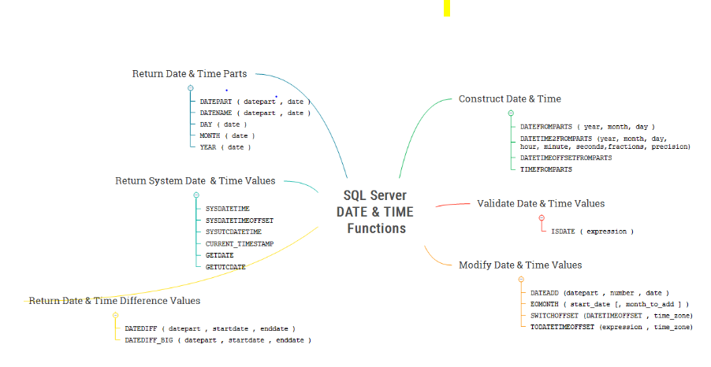
Date and Time Functions
Notes:
https://www.sqlservertutorial.net/sql-server-date-functions/

Slide 29
Window Functions
Function | Description
RANK | Assign a rank value to each row within a partition of a result set
DENSE_RANK | Assign a rank value to each row within a partition of a result, with no gaps in rank values.
PERCENT_RANK | Calculate the percent rank of a value in a set of values.
FIRST_VALUE | Get the value of the first row in an ordered partition of a result set.
LAST_VALUE | Get the value of the last row in an ordered partition of a result set.
LEAD | Provide access to a row at a given physical offset that follows the current row.
LAG | Provide access to a row at a given physical offset that comes before the current row.
ROW_NUMBER | Assign a unique sequential integer to rows within a partition of a result set
NTILE | Distribute rows of an ordered partition into a number of groups or buckets
Notes:
https://www.sqlservertutorial.net/sql-server-window-functions/

Slide 30
Null Functions
Function | Description
ISNULL | to replace NULL with a specified value.
NULLIF | returns NULL if two arguments are equal. Otherwise, it returns the first expression.
COALESCE | returns the first not-null value in a list.

Slide 31
Conversion Functions / System Functions
Function | Description
CAST | cast a value of one type to another.
CONVERT | convert a value of one type to another. Examples: Convert datetime to string , String to datetime , datetime to date
TRY_CAST | cast a value of one type to another and return NULL if the cast fails.
TRY_CONVERT | convert a value of one type to another and return the value to be translated into the specified type. It returns NULL if the convert fails.
Isnumeric | check if an expression is a valid numeric type.
Choose | return one of the two values based on the result of the first argument.
IIF | add if-else logic to a query.

Slide 32
Clauses in SQL Server

Slide 33
Clauses in SQL
4 Types of clauses
Where Clause
To get the rows from the table that satisfy one or more conditions, you use the WHERE clause
Group By
The GROUP BY clause allows you to arrange the rows of a query in groups.
The groups are determined by the columns that you specify in the GROUP BY clause.
Having
The HAVING clause is often used with the GROUP BY clause to filter groups based on
a specified list of conditions
Order By
Sort the rows either Ascending or Descending order. By default, order is Ascending order

Slide 34
Query hierarchy using where, Group by, Having and Order by
Query Sequence
Example : Display the customer details who are order more than two orders year wise.
SELECT
customer_id, YEAR (order_date),COUNT (order_id) order_count FROM sales.orders
WHERE customer_id in(1,5,10)
GROUP BY
customer_id,
YEAR (order_date)
HAVING
COUNT (order_id) >= 2
ORDER BY
customer_id;
Where
Group by
Having
Order by
Note : Order by clause always should use at the end of the SQL Statement

Slide 35
JOINS

Slide 36
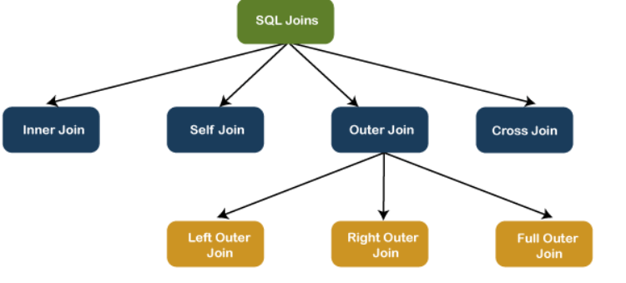
Joins
SQL Joins are used to fetch/retrieve data from two or more data tables, based on a join condition.
A join condition is a relationship among some columns in the data tables that take part in SQL join.
Types of JOINS in SQL Server

Slide 37
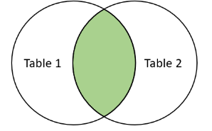
Inner Join
This JOIN returns all records from multiple tables that satisfy the specified join condition.
It is also called simple join or default join in SQL
Syntax for Inner join
SELECT columns
FROM table1 INNER JOIN table2
ON condition

Slide 38
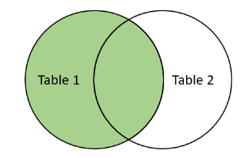
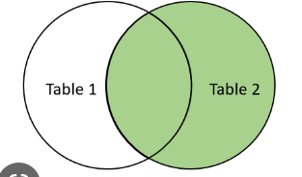
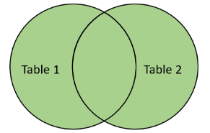
Outer Join
We can categories the OUTER JOIN further into three types:
LEFT OUTER JOIN
The LEFT OUTER JOIN retrieves all the records from the left table and matching rows from the right table.
It will return NULL when no matching record is found in the right-side table
RIGHT OUTER JOIN
The RIGHT OUTER JOIN retrieves all the records from the right-hand table and matched rows from the left-hand table.
It will return NULL when no matching record is found in the left-hand table.
FULL OUTER JOIN
The FULL OUTER JOIN in SQL Server returns a result that includes all rows from both tables.
The columns of the right-hand table return NULL when no matching records are found in the left-hand table.
And if no matching records are found in the right-hand table, the left-hand table column returns NULL.

Slide 39
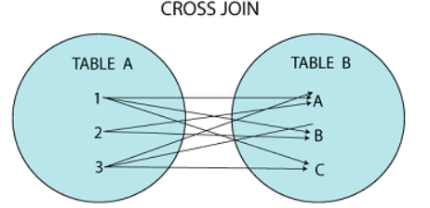
Cross join
CROSS JOIN in SQL Server combines all of the possibilities of two or more tables and returns a result that includes every row from all contributing tables.
It's also known as CARTESIAN JOIN because it produces the Cartesian product of all linked tables.
The Cartesian product represents all rows present in the first table multiplied by all rows present in the second table.
Syntax:
SELECT column_lists
FROM table1 CROSS JOIN table2;

Slide 40

Self Join
A table is joined to itself using the SELF JOIN. It means that each table row is combined with itself and with every other table row.
The SELF JOIN can be thought of as a JOIN of two copies of the same tables.
We can do this with the help of table name aliases to assign a specific name to each table's instance.
Note : If you want to join N tables means you should use N-1 join conditions.

Slide 41
Set Operators

Slide 42
Set Operators
Set operators are used to combine results from two or more SELECT statements.
There are certain rules which must be followed to perform operations using SET operators in SQL
1. The number and order of columns must be the same.
2. Data types must be compatible.
Types of Set Operators
1. Union
2. Union All
3. Intersect
4. Except

Slide 43
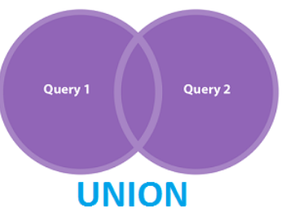
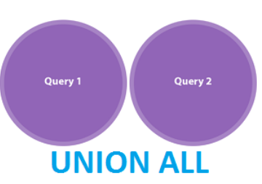
Union
Combine the result of two select statements.
Duplicate rows will be eliminated from the results
Syntax:
Union All
Combines all the records from both the queries.
Duplicate rows will be not be eliminated
Syntax:
Select */columns from Tab1
Union
Select */columns from Tab2
Select */columns from Tab1
Union All
Select */columns from Tab2

Slide 44
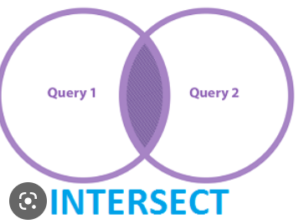
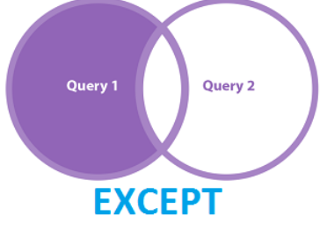
Intersect
It is used to combine two SELECT statements, but it only returns the records which are common from both SELECT statements.
Syntax
Except
It displays the rows which are present in the first query but absent in the second query with no duplicates.
Syntax
Select */columns from Tab1
Intersect
Select */columns from Tab2
Select */columns from Tab1
Except
Select */columns from Tab2

Slide 45
Constraints

Slide 46
Outline
What is Constraints and need for Constraints
Types of Constraints
How to add the constraints for the existing tables
How to see the list of constraints in Table / DB Level
Enable / Disable the constraints
Drop the constraints
Differences between Primary key and Unique constraints
On delete cascade and on delete set null

Slide 47
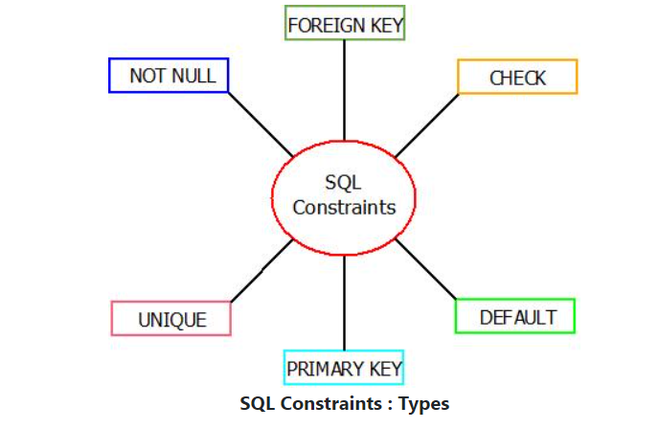
What is Constraints and need for Constraints ?
Constraints are the predefined set of rules and restrictions applied on the tables or columns for restricting unauthorized values to be inserted into the tables.
SQL Constraints restricts the type of data that is to be inserted in the table of the database allowing better results while executing SQL queries.
SQL Server categories the constraints into two types:
1. Table level constraints
2. Column level constraints
Types of Constraints

Slide 48
Not Null Constraint
The column should be a value. It does not store any null values
We can apply NOT NULL constraints either during the creation of the table or after creating the table using the ALTER statement.
CHECK Constraint
constraint is used to limit the range of values in a column.
We can apply CHECK constraints while creating the table or after creating the table using the ALTER statement.
DEFAULT Constraint
This constraint is used to insert the default value in the column.
The user does not specify any value for that column.
Example for Default Constraint after creating the table
ALTER TABLE salary_info
Add Constraint DF__Constraint DEFAULT (GETDATE()) FOR Salary_Date;

Slide 49
Primary Key
Each table must have one and only one primary key, not more than one.
A primary key cannot contain NULL values.
It may consist of one or more columns.
All columns must be defined as NOT NULL.
A primary key is clustered unique index by default.
UNIQUE KEY
constraint guarantees the uniqueness of the values.
Multiple unique keys can be defined on a table.
A column may contain a NULL value, but only one NULL value per column is allowed.
A unique key may create a non-clustered index by default.
FOREIGN KEY Constraint
A foreign key is a database key that links two tables together.
This constraint is also known as referencing key as it identifies the relationships between the tables by referencing a column of the child table containing the foreign key to the PRIMARY KEY column of the parent table.

Slide 50
Add the constraints for the existing table columns
Syntax : Alter table <Table_name> add constraint <constraint_name> <constraint_type>
Not Null constraint:
ALTER TABLE Sales ALTER COLUMN Vendor_Name varchar(75) NOT NULL;
Check constraint :
ALTER TABLE salary_info ADD CONSTRAINT CK_Salary CHECK (Salary>10000);
Primay Key :
ALTER TABLE person ADD CONSTRAINT PK__person PRIMARY KEY(ID);
Foreign Key :
ALTER TABLE Child_Table
ADD CONSTRAINT FK_Constraint_ID
FOREIGN KEY(ID) REFERENCES Parent_Table(PID);

Slide 51
TO see the list of Constraints details
SELECT CONSTRAINT_NAME, TABLE_SCHEMA, TABLE_NAME, CONSTRAINT_TYPE
FROM INFORMATION_SCHEMA.TABLE_CONSTRAINTS
WHERE TABLE_NAME=‘Product_dets’
Enable / disable the Constraints
Syntax: Alter table <table_name> disable constraint <constraint_name>
Alter table <table_name> enable constraint <constraint_name>
Drop the Constraints:
Syntax: Alter table <table_name> drop constraint <constraint_name>
ON DELETE CASCADE : It specifies that the child data is deleted when the parent data is deleted.
SET NULL : It means that the child data is set to NULL when the parent data is deleted or updated.

Slide 52
Q
A
Thank you

